Slide 1
Analysis of Orkney Energy Production and Consumption & DR Suggestions for the Utilization of Curtailed Energy
Members of Group 4:
Yitong Liu | 01625757
Faiz Fablillah | 01525542
Mingming Zhu | 01548939
Isabella Li | 01547310

Slide 2
Presentation Outline
Summary
Business problem overview
Summary of Analysis Approach and hypothesis
KPIs
Results of hypothesis analysis
DR Strategy
Summary of Findings & Calculation
Assumptions

Slide 3
Summary
Our objective - Find out whether there is any business case worth investing money in Demand Response (DR) scheme on Orkney Islands which can help in utilising curtailed energy.
Available dataset:
Residential Demand Data - contains data about demand of number of households and mean demand of that households in kw every 30 mins. We are making an assumption that demand stays same for 30 mins
Turbine Telemetry - contains data about power generated in kw, setpoint in kw and wind speed at interval of 1 min
After information about energy getting curtailed was obtained, we then:
Examine business case of investing money in selling curtailed energy
Help individual households in using curtailed energy at discounted price
Propose Demand Response strategy provider in implementing DR strategy which utilises curtailed energy. The report tries to find out win-win situation for all major parties involved.

Slide 4
Business Problem Overview
Orkney Islands has many wind turbines capable of generating 900 kW of power supply per turbine from renewable resources.
Currently energy produced at Orkney by using these wind turbines easily handles demands of local households of Orkney as well as they are net energy exporter due to surplus energy after local usage. Orkney is connected to GB by interconnector of 40 MW capacity which limits transfer of energy.
Orkney turbine owners are curtailing any energy which is produced after satisfying local household demands and interconnector capacity of 40 MW.
This is main concern raised by Orkney turbine owners as they feel that they can get more return on turbines if somehow energy which is getting curtailed due to interconnector capacity get used by Orkney households at discounted price for some purpose(Heating etc.).
We'll try to find out whether there is any business case to invest in Demand Response Strategy which can help in using these curtailed energy by local Households.It’ll results in win-win situation for turbine owners, local households and DR strategy provider.

Slide 5
Summary of Analysis Approach and hypothesis
Below is the high level approach that we took to analyze the data
Brainstormed potential hypothesis
Decided on hypothesis
Performed data cleaning
Performed data analysis
Evaluated hypothesis
Derived business insight
List Of Hypothesis:
Minimum wind speed to achieve maximum power output
Wind turbine needs to be shut down for safety reasons if wind exceeds 25m/s
More power is supplied in winter season
Temperature is positively correlated to power supply
Demand is higher in winter and lower in summer
Demand is higher on weekend/weekdays
Curtailment happened mostly on weekends
More curtailment in summer and winter
Length of power curtailment in minutes
set_point =0 means there is a grid wide blackout

Slide 6
KPIs
Energy Curtailment: Whenever turbine produce energy which is more than combined Orkney households requirement and 40 MW interconnector capacity then that extra energy is getting curtailed.
Loss of Revenue for turbine owners due to energy curtailment.
Use of Curtailed Energy by Orkney Households at Discounted Price (Room heating etc).
DR Penetration: Level of DR Penetration required to utilise all curtailed energy. DR Penetration % refers to % of total households involved in DR exercise.
Cost of DR Implementation: Total cost required for implementation of DR strategy based on % of DR penetration.

Slide 7
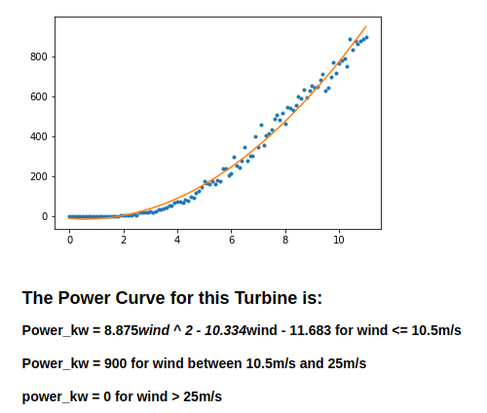
Results
Hypothesis: Wind turbine needs to be shut down for safety reasons if wind exceeds 25m/s
Hypothesis: Setpoint =0 means there is a grid wide blackout or turbine is shutdown by owner
Hypothesis: Minimum wind speed to achieve maximum power output. Max power can be reached when wind speed > 11m/s. (approx)
Findings:
Turbines generate maximum power of around 900 kw touching capacity of turbine at speed of around 11m/s.
Turbines are shutdown at speed more than 25 m/s.
Setpoint=0 represents turbine shutdown.

Slide 8
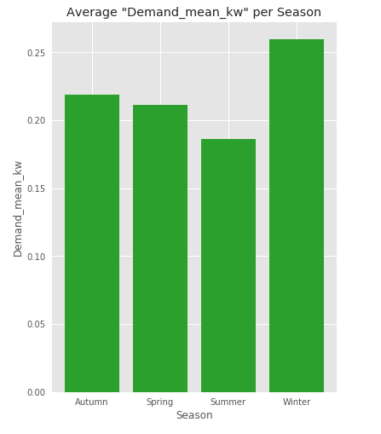
Hypothesis: Demand is higher in winter and lower in summer
Findings:
Graph shows average demands per households during Autumn, Spring, Summer and Winter seasons.
Average household demand during Winter is around 0.26 kw whereas during summer it’s around 0.18 kw.

Slide 9
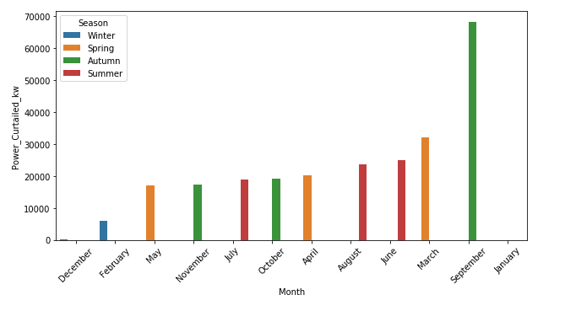
Hypothesis: More curtailment in summer than winter
Findings:
Curtailment is more in summer around 2000-2800 kw.
Winter has least curtailment.
Autumn have exception with highest curtailment in September.

Slide 10
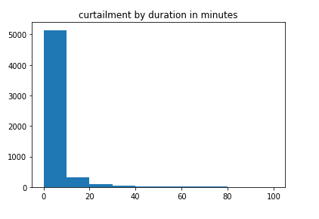
Hypothesis: Analysis of Length of power curtailment in minutes. Most of the curtailments lasted less than 20 minutes. 96% of curtailment lasted less than 20 minutes.
Findings:
96% of the curtailment just last 20 minutes.
Remaining 6% of curtailment last more than 20 minutes.

Slide 11
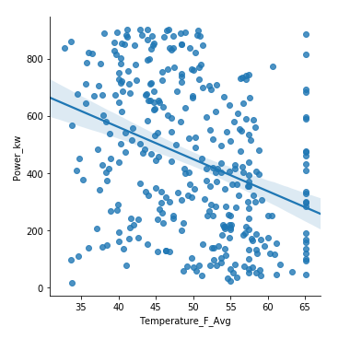
Hypothesis: Temperature is negatively correlated to Power supply
Findings:
Power supply generated by turbines is negatively correlated with temperature.
As temperature increases, power generation decreases.

Slide 12
DR Strategy
Assumptions:
There are 10000 households in Orkney Islands.
Each household who takes up the DR scheme can turn on their heating storage which increase power by 5kW.
Household demand within a 30-minute window is assumed to be constant.
We use 2017 data as sample
We assume that penetration = number of household installing smart heating storages (5kw). Residential demand is not used for calculation in this case for the reasons.
We are actually assuming that the whole electricity demand from a household can be stored hence reducing the curtailment. We think that its not a reasonable assumption since that many of the electricity demand (ie. cooking, watching TV, lighting) from a household cannot be stored like a heater.

Slide 13
DR Strategy (Contd.)
Max heating units needed to completely avoid curtailment
A maximum of 178 heating units will be needed to completely offset the total curtailment during the observable period for the single wind turbine.

Slide 14
DR Strategy (Contd.)
Devices requirement to handle curtailed energy of ONE turbine.
Assuming each heater can increase 5kW of power when turned on, different device penetrations can achieve the following result:
10 devices is sufficient to offset 12% of energy curtailed from one wind farm.
20 devices is sufficient to offset 23% of energy curtailed from one wind farm.
50 devices is sufficient to offset 51% of energy curtailed from one wind farm.
100 devices is sufficient to offset 83% of energy curtailed from one wind farm.

Slide 15
DR Strategy (Contd.)
Devices requirement to handle curtailed energy of ALL turbine.
Assuming each heater can increase 5kW of power when turned on, different device penetrations can achieve the following result:
500 devices is sufficient to offset 11.5% of energy curtailed from ALL wind farms
1000 devices is sufficient to offset 22% of energy curtailed from ALL wind farms
2000 devices is sufficient to offset 41% of energy curtailed from ALL wind farms
5000 devices is sufficient to offset 82% of energy curtailed from ALL wind farms

Slide 16
DR Strategy (Contd.)
DR Penetration:
Assuming that there is a total of 10000 households across the Orkney Island and that one household installs one heater, different household penetrations can achieve the following result:
5% households penetration is sufficient to offset 11.5% of energy curtailed from ALL wind farms
10% households penetration is sufficient to offset 22% of energy curtailed from ALL wind farms
20% households penetration is sufficient to offset 41% of energy curtailed from ALL wind farms
50% households penetration is sufficient to offset 82% of energy curtailed from ALL wind farms

Slide 17
DR Strategy (Contd.)
Value of this energy curtailed:
A total of 3213 pounds is estimated to be saved from the reduction in curtailment for one wind turbine. Assuming that a smart meter costs 15 pounds and all the other fixed costs are 0. Based on the result that a maximum of 178 devices will be used to offset all the curtailments for a single wind turbine derived from the above analysis, we can get that the profit will be approximately 3213- 178* 15 = 543 pounds for a single wind turbine in 2017.
A total of 166007 pounds is estimated to be saved from the reduction in curtailment for all wind turbines. Assuming that a smart meter costs 15 pounds and all the other fixed costs are 0. Based on the result that a maximum of 178 devices will be used to offset all the curtailments for a single wind turbine derived from the above analysis, we can get that the profit will be approximately 166007- (178*15* (54750-8250))/900 = 28057 pounds for all wind turbines across the Orkey Islands in 2017.

Slide 18
Summary of findings (EDA)
Below are list of findings from Exploratory Data Analysis:
Average power supply is around 455 kw for year 2017. Average wind speed is around 10.17 m/s.
Average residential demand is around 0.21 -0.24 kw for year 2017.
Average demand during Winter (0.26 kw) is highest compared to Autumn, Spring and Summer (0.19-0.22 kw).
Average demand during off-peak hours is around 0.15-0.18 kw. Also average demand during peak hours is 0.29-0.31 kw.
The highest curtailment can be seen in Sep with 68204 kw in total. What's interesting is although there is high power supply in Jan, no curtailment is spotted.

Slide 19
Summary Of Findings (Calculations)
Below are list of findings from Calculations:
We have come to conclusion that investments in this project (HSO) is worthy as it will generate positive profit and that less energy will be wasted, which is more environmentally friendly.
There were 134 mWh and 77.6 mWh curtailments for 2016 and 2017 respectively for the observed single wind turbine.There were 6924 mWh and 4011 mWh curtailments for 2016 and 2017 respectively across Orkney Island.
A total of 166,007 pounds is estimated to be saved from the reduction in curtailment for all wind turbines in 2017 and 28,057 pounds will be generated as profit.

Slide 20
Strengths & Limitations
Strengths:
Data has been fully explored to find out all possible relation as well as patterns.
All results are shown with visual proofs.
Solution achieves 100% usage of curtailed energy in case of proper implementation of DR.
Limitations:
All calculations are approx.
Information given is very limited that many assumptions are needed to support the result, which may not be reliable in the real world.
Costing structure is unclear and during implementation a lot more costing may be involved.
Wastage during the electricity transmission and storage has not been taken into consideration.
Data from the demand side is actually important to our analysis but we ignore it due to its unreasonableness.
A longer period of data may be needed for comparison and time series analysis.

Slide 21
Thank you for listening, any questions?

